Slide 1
Passerelles numériques
A Gateway for Life
Chapter8: Abstract Class

Slide 2
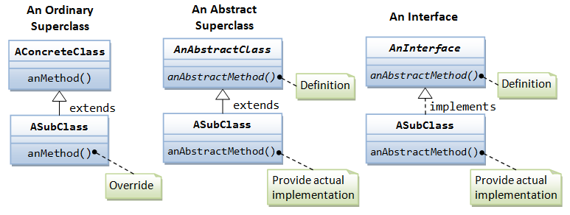
Abstraction
Processing of hiding the set of services
By using abstract class and interface
Abstract class may or may not contain abstract method

Slide 3
Abstract Method
Normal methods: normal java method
Method declaration and implementation
Ex:
void m1(){
//implementation
}
Abstract methods:
Only method declaration and no implementation (body)
Use abstract keyword
Ex:
abstract void m1();

Slide 4
Abstract Class
Normal class:
contains only normal methods
Object creation is possible
Ex: write on the board
Abstract class:
May or may not contains abstract method
use abstract keyword
Object creation isn’t possible
Ex: write on the board
Notes:
How to prevent inheritance ? -> declare class as final
How to prevent method overriding? -> declare method as final
How to prevent object creation ? -> declare class abstract

Slide 5
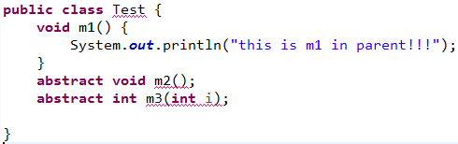

Notes:
If it contains abstract method it must declared as abstract class

Slide 6
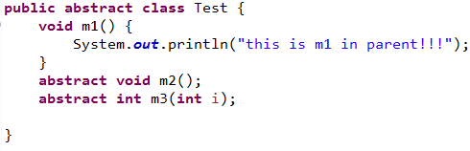


Slide 7
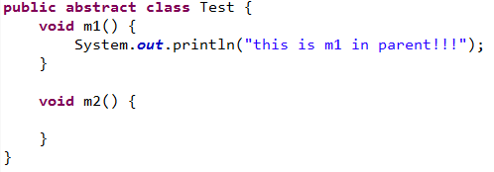
Notes:
Abstract class may not contain abstract method

Slide 8


Slide 9
Activity
Create normal class but contains abstract method. See what will happen?
Create abstract class but contains no abstract method. See what will happen?
Then try to create object!
15 minutes
Notes:
Create normal class but contains abstract method. See what will happen?
Create abstract class but contains no abstract method. See what will happen?
Then try to create object!
Then ask question: how to call the normal method and how those abstract methods?

Slide 10
Abstract Class
Sub Class
Handles the detail implementation of those abstract methods from its parent
How??? Let’s do it together
Notes:
Write the implementation in the child classes.
During the demo ask them is the sub class is abstract or normal???

Slide 11
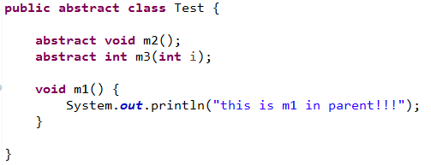
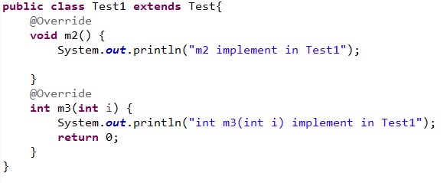

Slide 12
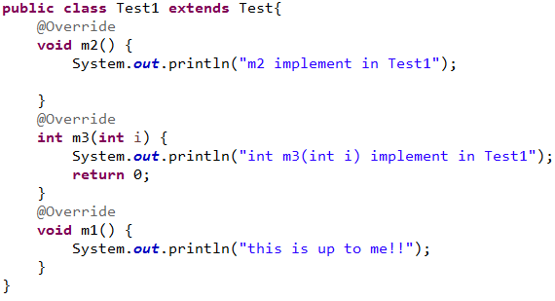
Notes:
Test t1=new Test1(); // valid or not??? Yes why: at compile time it will check the methods in the Test
T1.m1();
T1.m2();

Slide 13
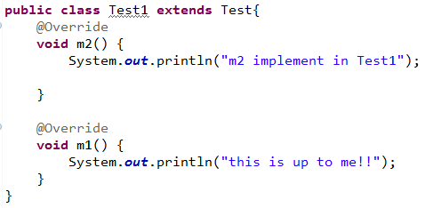

Slide 14
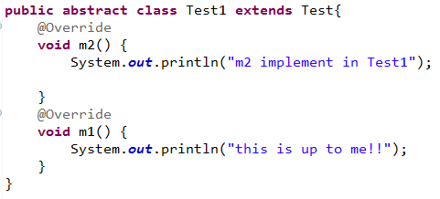

Slide 15
Abstract Class
The sub class extends abstract parent class needs to implement all the abstract methods in its parent class
If sub class extends abstract parent class doesn’t want to implement all the abstract methods in its parent class it must declared as abstract. But this sub class couldn’t create any object.

Slide 16
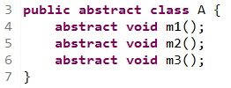
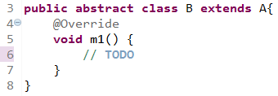
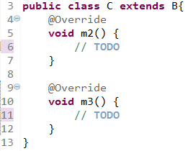
How many methods does class B has?
Could class B create object?
How many methods does class C has?
Could class C create object?

Slide 17
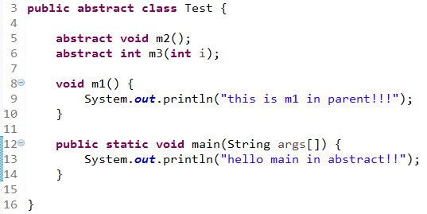
Notes:
Would it be possible to create main method (public static void main) inside the abstract class?? // Yes, it is but we can’t create any object inside that main method.

Slide 18
Constructor in Abstract Class
Object creation is not possible
In side the abstract class constructor declaration is possible or not?
It is possible to declare constructor but no meaning of object creation.

Slide 19
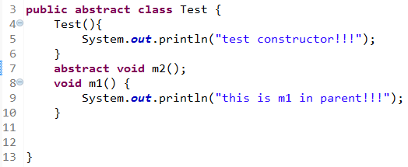
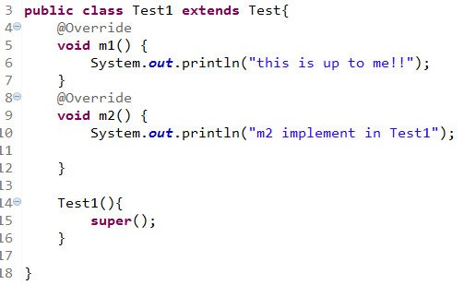
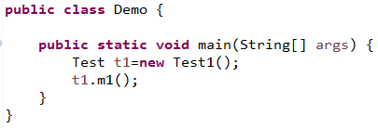
Notes:
====output=====
test constructor!!!
this is up to me!!
=============
Could we write Test t = new Test(); ??? //no

Slide 20
Abstract Class
Possible to declare variables (not abstract)
Possible to declare normal/abstract methods
Possible to declare constructors
Notes:
Possible to declare instance block
Possible to declare static block

Slide 21
What have you learned?

Slide 22
Q&A

